Slide 1


[EMNLP22] Bi-Directional Iterative Prompt-Tuning for Event Argument Extraction
$Lu Dai^{1}$, $Bang Wang^{1}$, $Wei Xiang^{1}$, $Yijun Mo^{2∗}$
$$School of Electronic Information and Communications,$$
$$Huazhong University of Science and Technology, Wuhan, China^{1}$$
$$School of Computer Science and Technology,$$
$$Huazhong University of Science and Technology, Wuhan, China^{2}$$
{dailu18, wangbang, xiangwei, moyj}@hust.edu.cn
Xuanwen Ding

Slide 2
Event Argument Extraction（EAE）
Event types： "Attack"
Event trigger： "fired"
Event argument
"Iraqis have fired sand missiles and AAA at aircraft"
Argument role
"Attacker"
"Instrument"
"Instrument"
"Target"

Slide 3

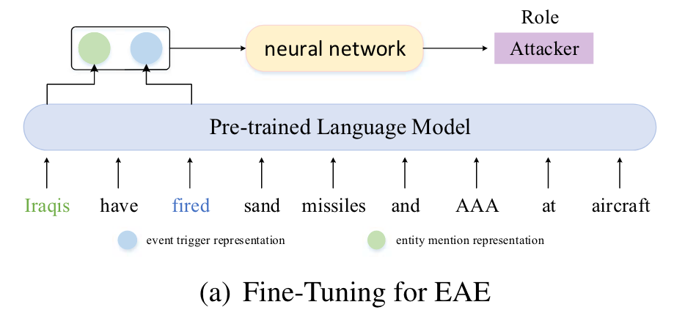

Fine-Tuning for EAE
use a pre-trained language model to obtain semantic representations
gap between the EAE task and the objective form of pre-training
heavily depend on extensive annotated data and perform poorly in low-resource data scenarios

Slide 4
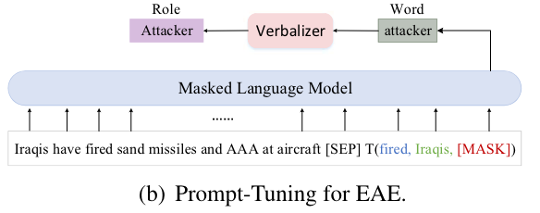
Prompt-Tuning for EAE
bridge the gap between the EAE task and the pre-training task
achieve significantly better performance than fine-tuning methods in low-resource data scenarios
not as good as the state-of-the-art fine-tuning method ONEIE (Lin et al., 2020) in high-resource data scenarios

Slide 5
Overview
Objective：
To achieve excellent performance in both low-resource and high-resource data scenarios, we leverage entity information to model EAE as a clozestyle task and use a masked language model to handle the task.
Challenges：
The typical human-written verbalizer is not a good choice for EAE.
Event argument interactions are not explored.
Methods：bi-directional iterative prompt-tuning (BIP)
Argument interactions：a forward iterative prompt and a backward iterative prompt
Verbalizer：redefine the argument role types and assign a virtual label word based on the semantic of the argument role
Templates：hard template, soft template, and hard-soft template

Slide 6
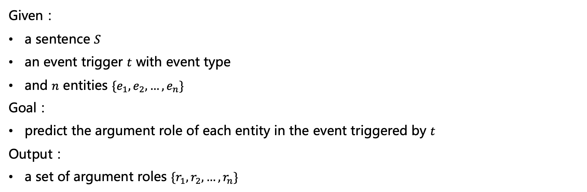
Problem Description
Given：
a sentence $S$
an event trigger $t$ with event type
and $n$ entities $\{e_{1}, e_{2}, …, e_{n}\}$
Goal：
predict the argument role of each entity in the event triggered by $t$
Output：
a set of argument roles $\{r_{1}, r_{2}, …, r_{n}\}$

Slide 7
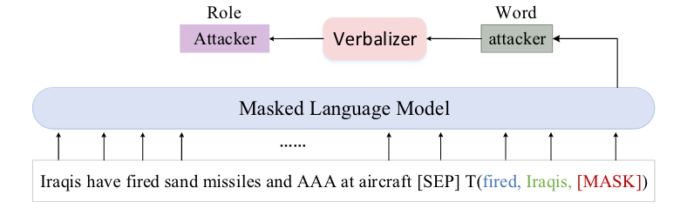




Problem Description
$$T(t,e_{i},\left[MASK\right])$$
$$T\left(fired,Iraqis,\left[MASK\right]\right)$$
"For the attack event triggered by the fired, the person, Iraqis, is [MASK]", where "attack" represents the event type of the trigger "fired" and "person" represents the entity type of the entity "Iraqis".
$$x_{i} = S \left[SEP\right]T(t, e_{i}, [MASK])$$
$$s_{ij} = C_{i}([MASK] = l_{j})$$

Slide 8
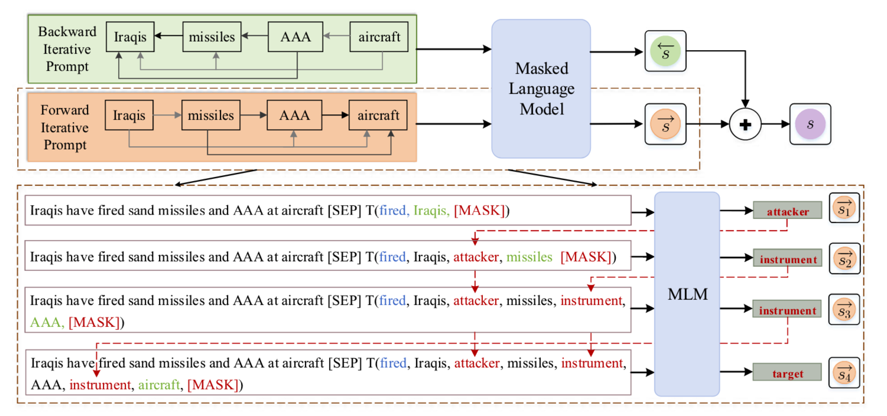



Overall Framework
$$FIP\left(e_{i}\right)=T(t,e_{1}, \vec{l_{1}},…,e_{i−1},\vec{l_{i−1} },e_{i},\left[MASK\right])$$
$$\vec{s_{i}}=MLM(S \left[SEP\right] FIP\left(e_{i}\right))$$
$$BIP\left(e_{i}\right)=T(t,e_{n},\overset{⃖}{l_{n}},…,e_{i+1},\overset{⃖}{l_{i+1}},e_{i},\left[MASK\right])$$
$$\overset{⃖}{s_{i}}=MLM(S \left[SEP\right] BIP\left(e_{i}\right))$$
$$s_{i}=\vec{s_{i}}+\overset{⃖}{s_{i}}$$

Slide 9
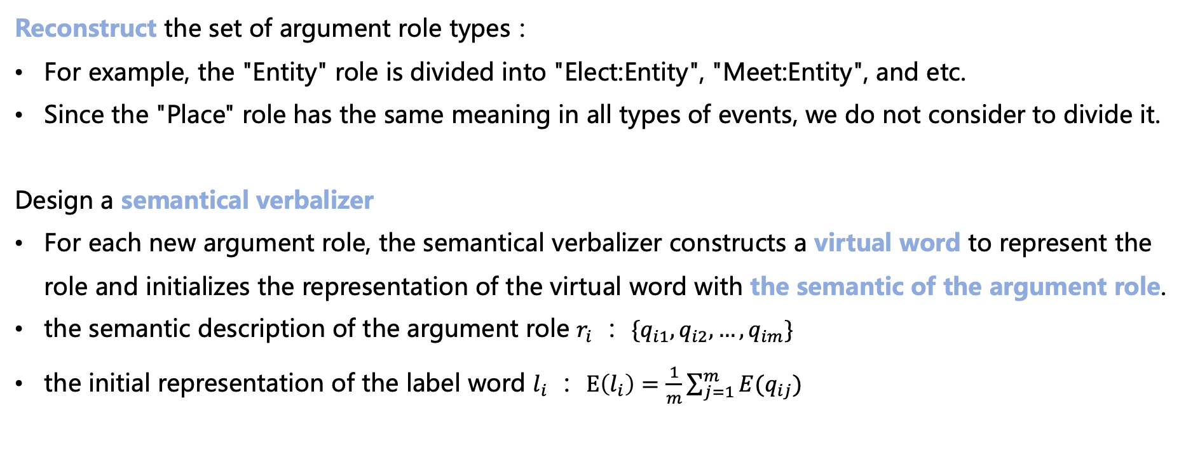
Semantical Verbalizer
Reconstruct the set of argument role types：
For example, the "Entity" role is divided into "Elect:Entity", "Meet:Entity", and etc.
Since the "Place" role has the same meaning in all types of events, we do not consider to divide it.
Design a semantical verbalizer
For each new argument role, the semantical verbalizer constructs a virtual word to represent the role and initializes the representation of the virtual word with the semantic of the argument role.
the semantic description of the argument role $r_{i}$ ： $\{q_{i1},q_{i2},…,q_{im}\}$
the initial representation of the label word $l_{i}$ ： $E\left(l_{i}\right)=\frac{1}{m}\sum_{j=1}^{m}{E(q_{ij})}$

Slide 10
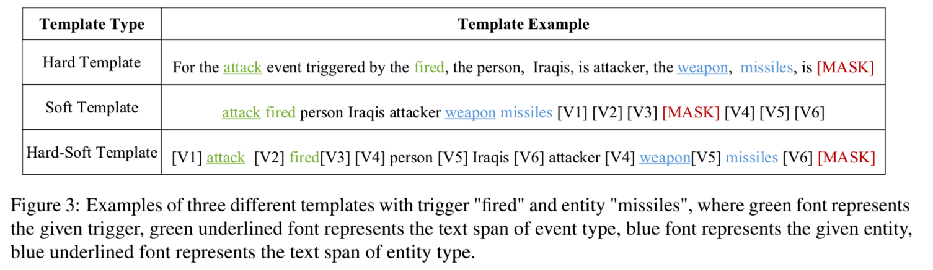


Templates
Hard Template
$$For the w^{t} event triggered by the t, the w_{1}^{e}, {\hat{e}}_{1}, is \vec{l_{1}}, ... , the w_{i−1}^{e}, {\hat{e}}_{i−1}, is \vec{l_{i−1}}, the w_{i}^{e} , {\hat{e}}_{i} is [MASK]$$
Soft Template
$$w^{t} t w_{1}^{e} {\hat{e}}_{1} \vec{l_{1}}... w_{i−1}^{e} {\hat{e}}_{i−1} \vec{l_{i−1}} w_{i}^{e} {\hat{e}}_{i} [V1] [V2] [V3] [MASK] [V4] [V5] [V6]$$
Hard-Soft Template
$$\left[V1\right]w^{t} \left[V2\right] t \left[V3\right]\left[V4\right] w_{1}^{e} \left[V5\right] {\hat{e}}_{1} \left[V6\right]{ \hat{l}}_{1} , ... , \left[V4\right]w_{i−1}^{e} \left[V5\right]{\hat{e}}_{i−1} \left[V6\right] \vec{l_{i−1}}\left[V4\right]w_{i}^{e} \left[V5\right]{\hat{e}}_{i} [V6] [MASK]$$
$$w^{t}：the text span of event type of the given trigger$$
$$w_{i}^{e}：the text span of the entity type of the i−th entity$$
$$t：trigger$$
$${\hat{e}}_{i}=ε_{i1} or ε_{i2} or …or ε_{id}$$

Slide 11


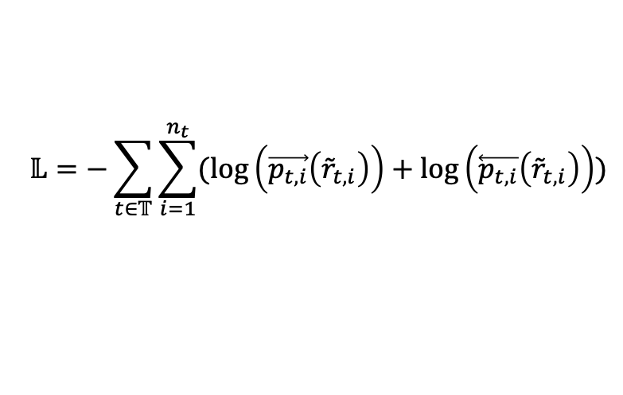
Training
$$\vec{p_{t,i}}=softmax(\vec{s_{i}})$$
$$\overset{⃖}{p_{t,i}}=softmax(\overset{⃖}{s_{i}})$$
$$𝕃=−\sum_{t∈𝕋}{\sum_{i=1}^{n_{t}}{(\log\left(\vec{p_{t,i}}\left({\tilde{r}}_{t,i}\right)\right)+\log\left(\overset{⃖}{p_{t,i}}\left({\tilde{r}}_{t,i}\right)\right))}}$$

Slide 12
Experiments
Experimental Setup ：
ACE2005 English dataset（33 event subtypes, 7 entity types and 22 argument roles）
Bert-base & Roberta-base
AdamW
Batch size ： 4
Learning rate ： 1e-5
Low-resource setting ： 1%, 5%, 10%, 20%, 50%, 75%
A NVIDIA Quadro P4000 GPU

Slide 13
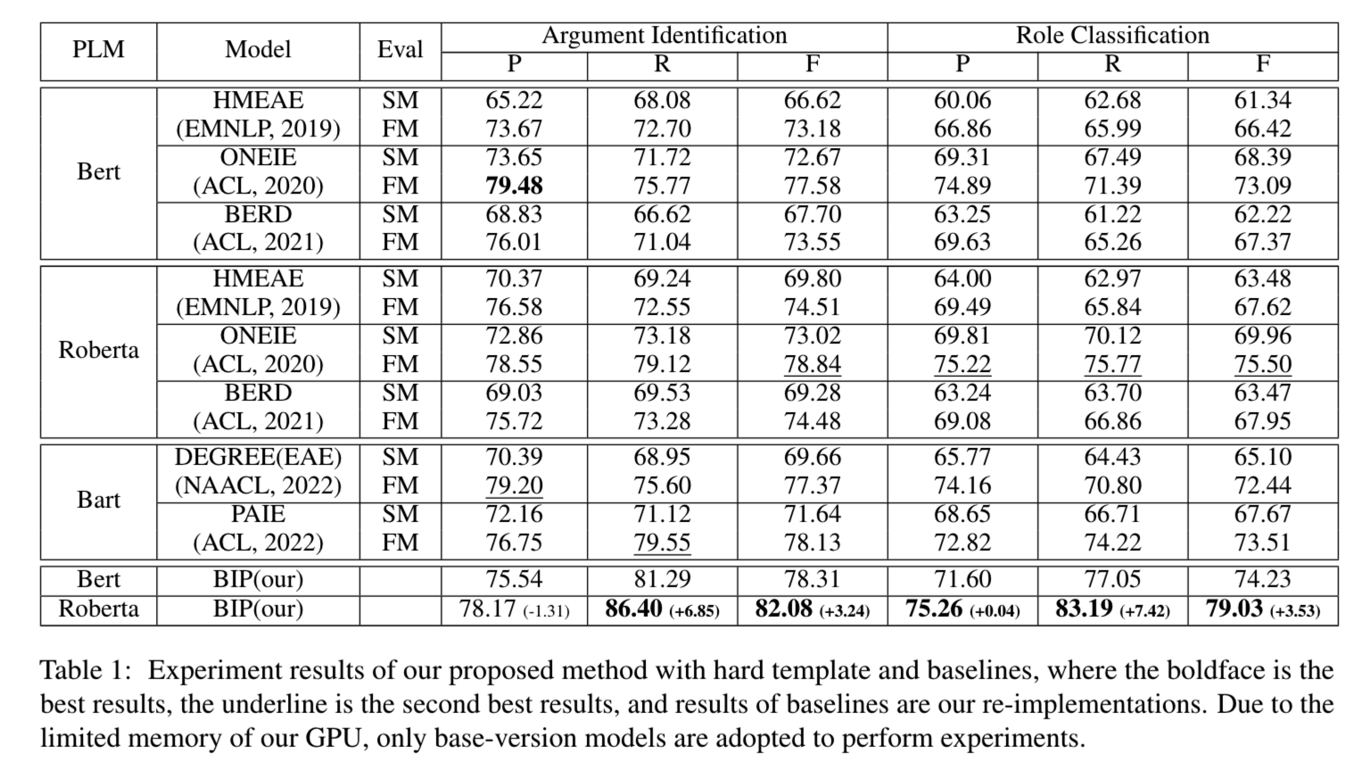
Overall Results
strict match (SM)：
an event argument is correctly classified only if its offsets and role type match the golden argument
flexible match (FM)：
an argument is correctly classified if its offsets match any of the entity mentions co-referenced with the golden argument and role type match the golden argument

Slide 14
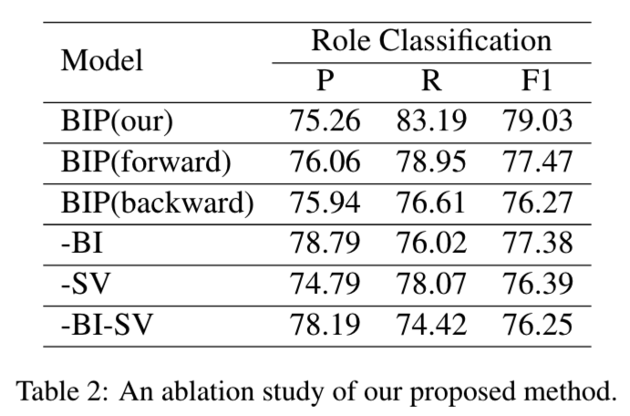
Ablation Study

Slide 15
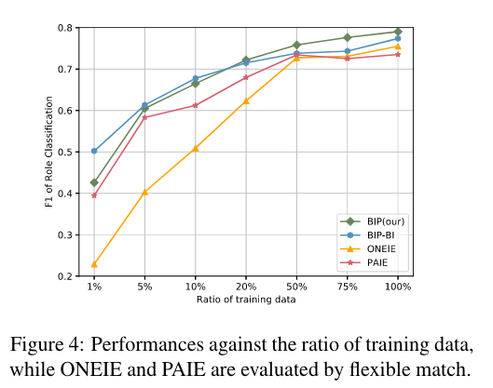
Low-Resource Event Argument Extraction

Slide 16
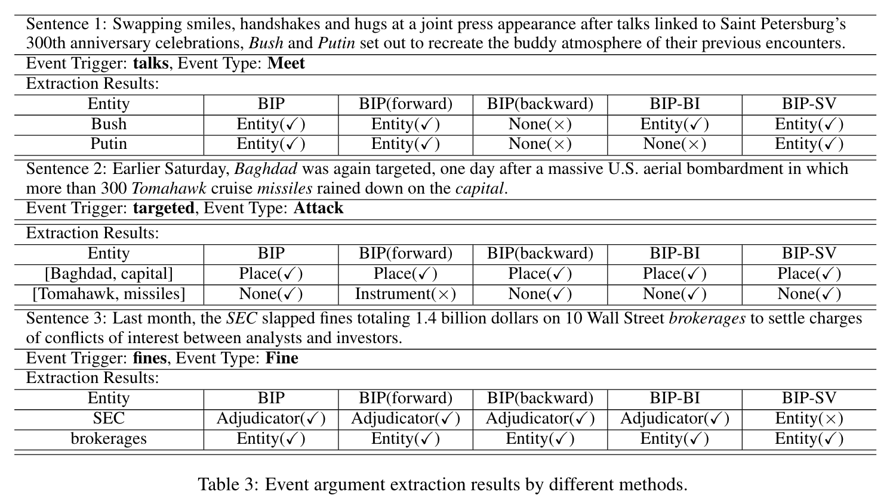
Case Study
SEC（美国证券交易委员会）
（BIP-SV）SEC->“judge”
（BIP）SEC->“the entity doing the fining”

Slide 17
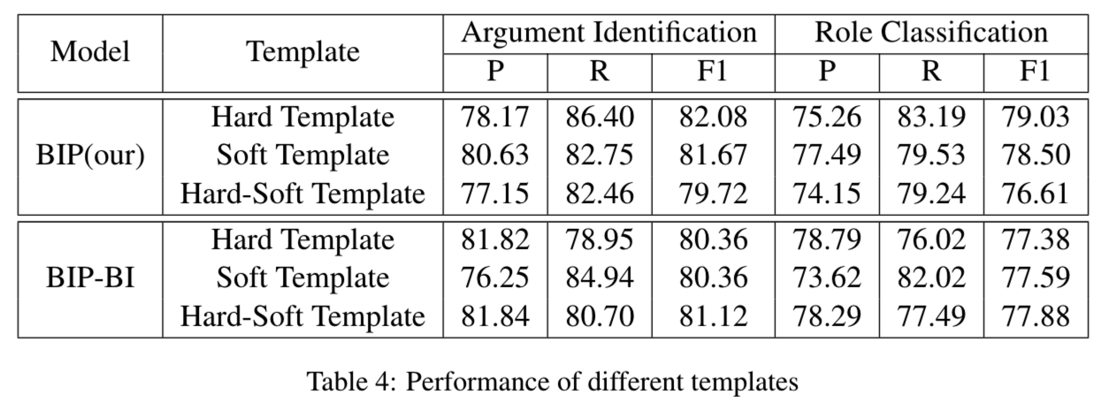
Prompt Variants

Slide 18
Conclusion & Limitation
Conclusion
Regard event argument extraction as a cloze-style task
Bi-directional iterative prompt-tuning method
For the template construction in each prompt, the predicted argument role information is introduced to capture argument interactions
A novel semantical verbalizer is designed based on the semantic of the argument role
Three kinds of templates are designed and discussed
Limitations
not suitable for the situation that entities are not provided
the speed of our method is slower due to that it predicts the argument role of each entity one by one

